Slide 1

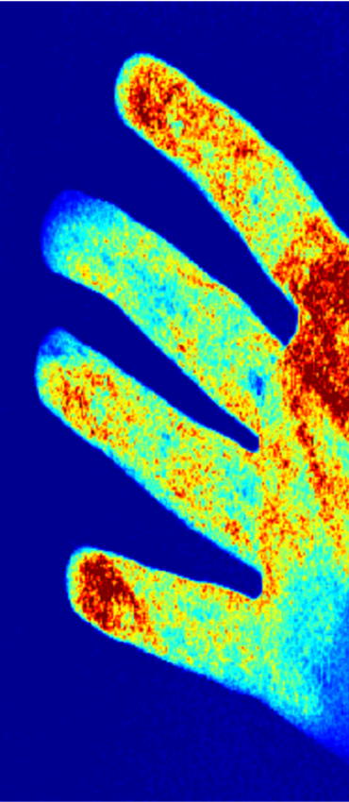
Skin Perfusion Photography
Guy Satat Christopher Barsi Ramesh Raskar
MIT Media Lab
Camera Culture Group
IEEE International Conference on Computational Photography 2014

Slide 2
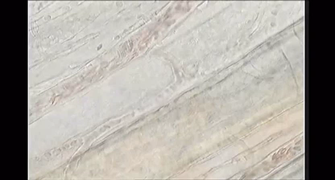
Computational Photography
↓
Medical Imaging
YouTube \ capillary flow 0002

Slide 3
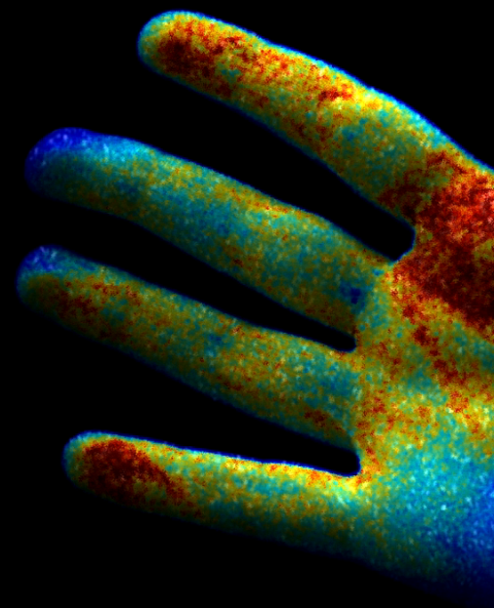
Skin Perfusion
Blood flow into tissue
Measurement:
Based on the wave nature of light
Flow properties:
Brownian movement
Within capillaries
Interesting for:
- Wounds and burns recovery
- Plastic and reconstructive surgeries

Slide 4
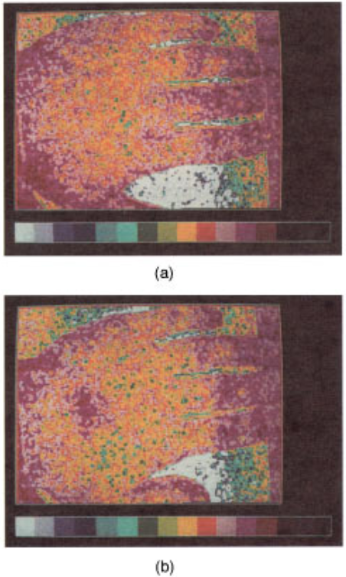
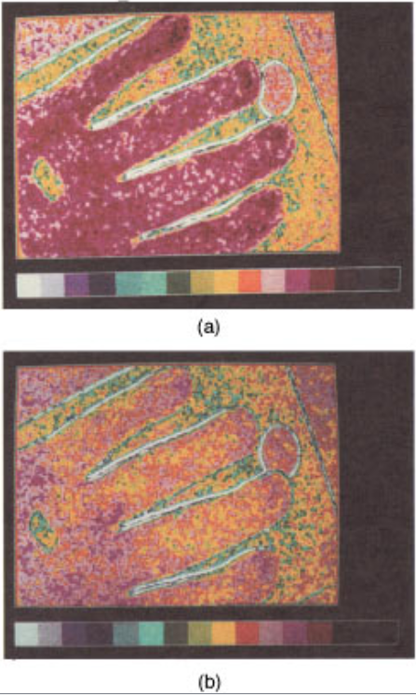
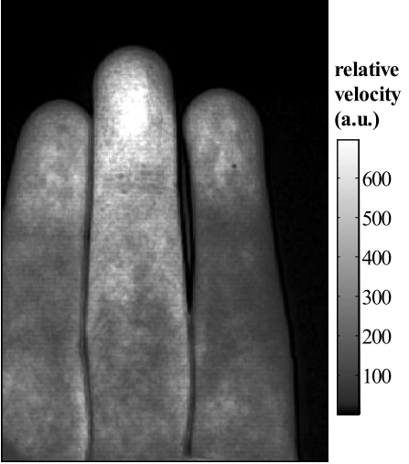
Imaging Blood Flow
Laser Speckle Contrast Imaging (LSCI)
Briers et al. 1996
Smith et al. 2006

Slide 5
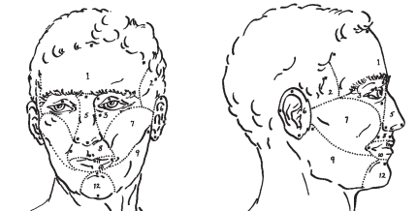
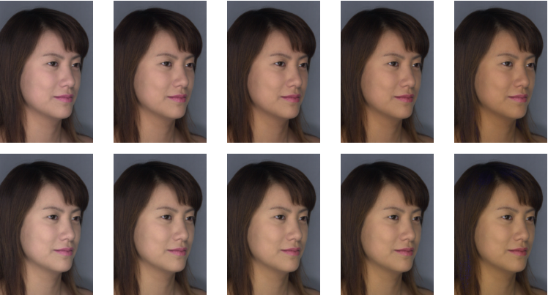
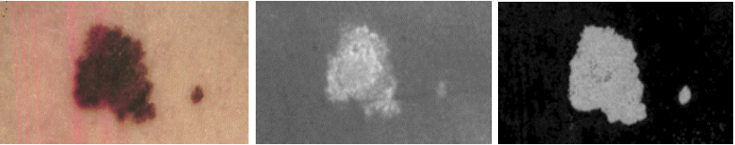
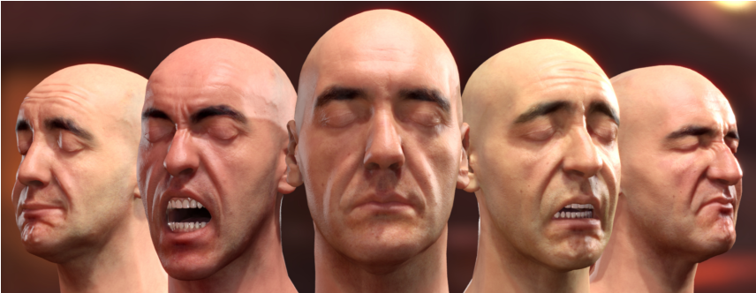
Other Applications of Skin Analysis
Capillary Structure
Skin color
Moretti et al. 1959
Lesion Analysis
Tsumura et al. 2003
Cotton et al. 1999
Jimenez et al. 2010

Slide 6
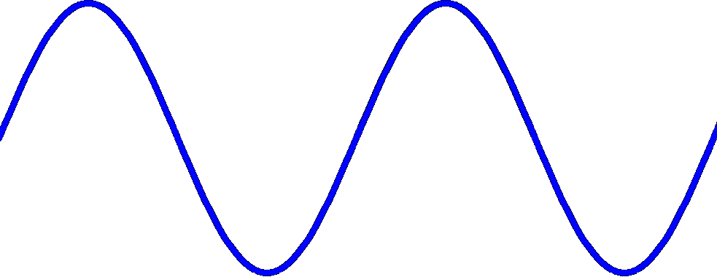
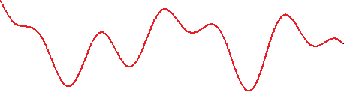
Interference and Speckle
Constructive
Deconstructive
Bright
Dark
intensity
illum.
scattering
rough surface

Slide 7

Speckle

Slide 8
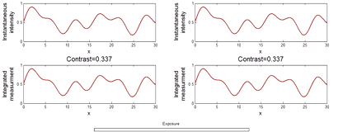

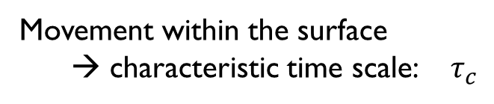

Interference and Speckle
intensity
illum.
scattering
Movement within the surface
→ characteristic time scale: $τ_{c}$
rough surface
Large $τ_{c}$→ High contrast
Small $τ_{c}$→ Low contrast

Slide 9
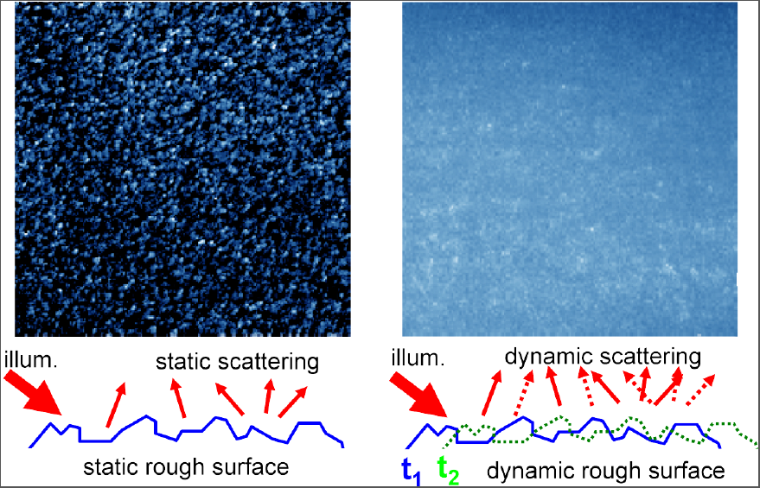
Interference and Speckle
intensity
illum.
scattering
rough surface
Large $τ_{c}$→ High contrast
Small $τ_{c}$→ Low contrast

Slide 10
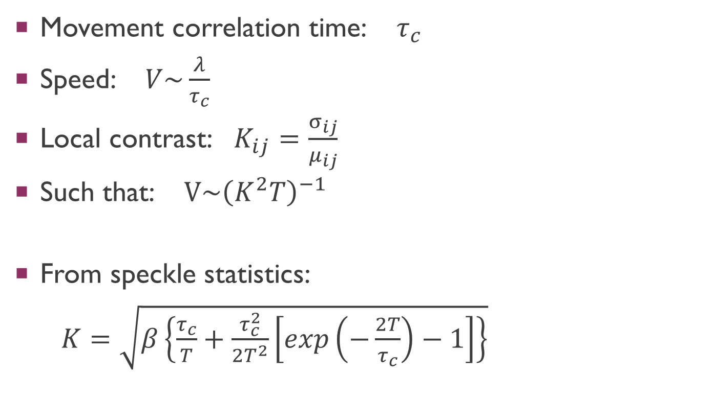
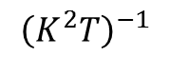
LSCI – Speckle to Speed Map Model
Movement correlation time: $τ_{c}$
Speed: $V\sim \frac{λ}{τ_{c}}$
Local contrast: $K_{ij}=\frac{σ_{ij}}{μ_{ij}}$
Such that: $V\sim {\left(K^{2}T\right)}^{−1}$
From speckle statistics:
$K=\sqrt{β\left\{\frac{τ_{c}}{T}+\frac{τ_{c}^{2}}{{2T}^{2}}\left[exp\left(−\frac{2T}{τ_{c}}\right)−1\right]\right\}}$
$${\left(K^{2}T\right)}^{−1}$$
Fercher et al. 1981

Slide 11
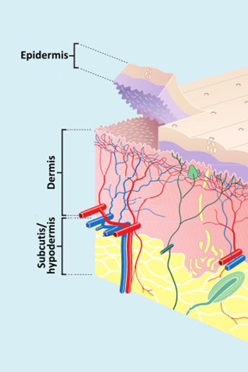
The Problem of Subsurface Scattering
Skin is composed of multiple tissue layers
Wikipedia \ Skin

Slide 12
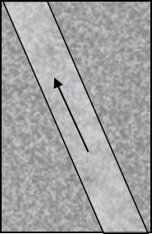
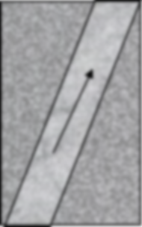


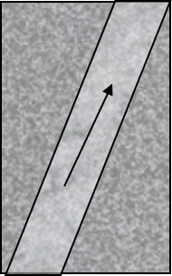
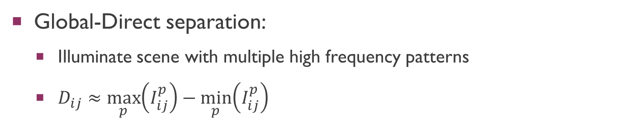
The Solution: Global-Direct Separation
measurement
illum.
Skin
Tissue
sensor
direct
global
+
Global-Direct separation:
Illuminate scene with multiple high frequency patterns
$D_{ij}≈\max_{p}\left(I_{ij}^{p}\right)−\min_{p}\left(I_{ij}^{p}\right)$
Speckle is a natural high frequency pattern
Nayar et al. 2006

Slide 13
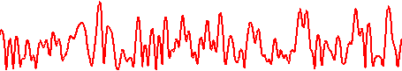
Simulation
Measurements
Speed Reconstruction
Slow Fast
tissue
Sum of Measurements
(Baseline)
skin
2
LSCI
I
C
0
1
C
4
P
z
Direct component
LSCI
illum.

Slide 14
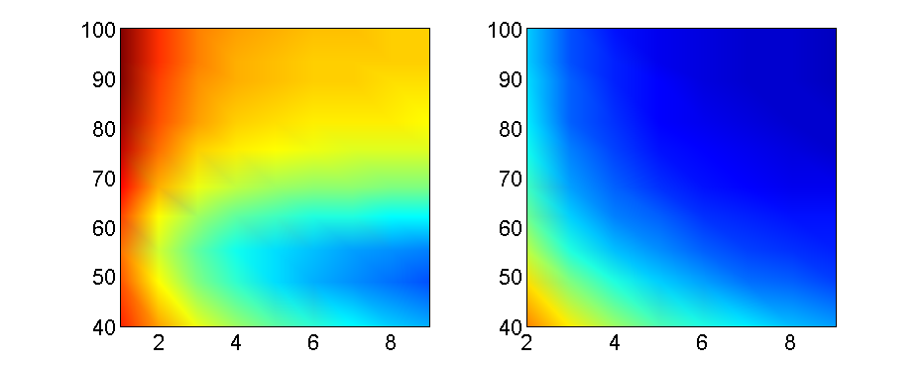
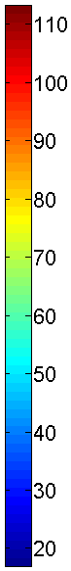
Sensitivity Analysis
Baseline
Direct
SNR
Speed estimation error
# Illumination patterns
# Illumination patterns
Noise helps?
More illumination patterns → easier direct separation

Slide 15
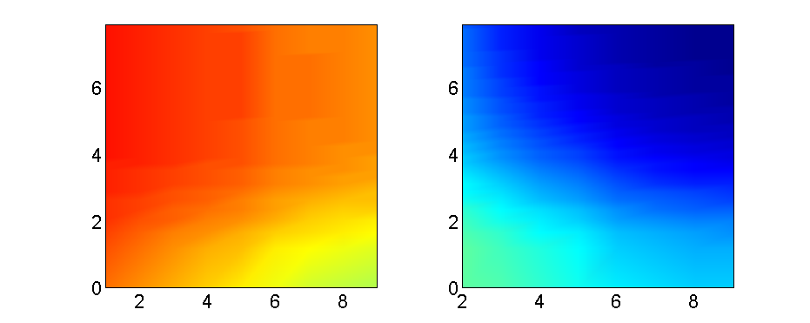
Sensitivity Analysis
Effect of blurring the internal reflections
Baseline
Direct
Rear layer depth [mm]
Speed estimation error
# Illumination patterns
# Illumination patterns
Blurry subsurface reflection → reduced local contrast
Blurry subsurface reflection → easy global separation

Slide 16
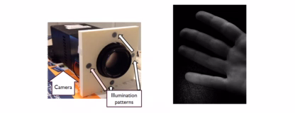
Data Acquisition

Slide 17
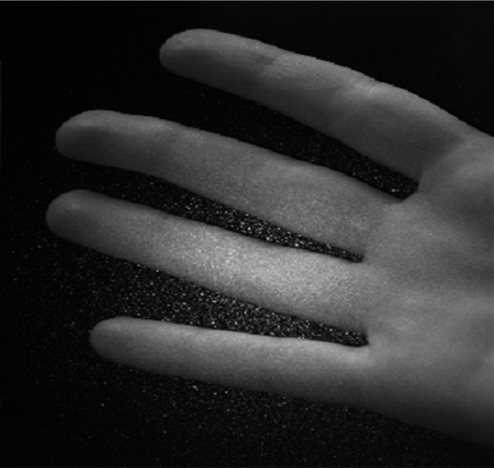
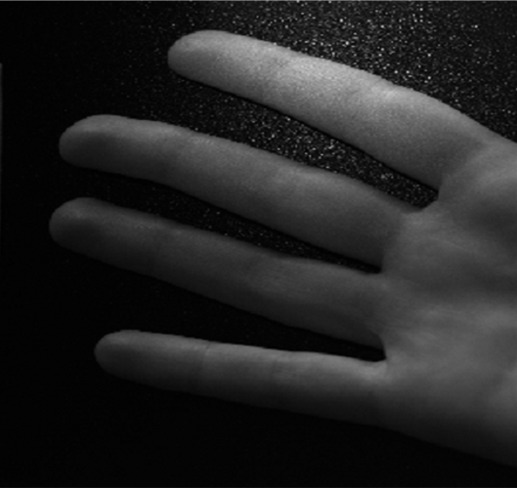
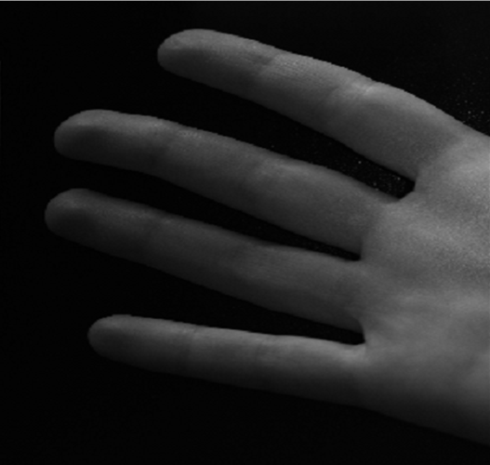
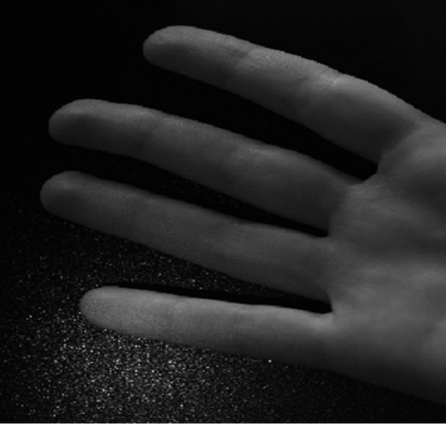
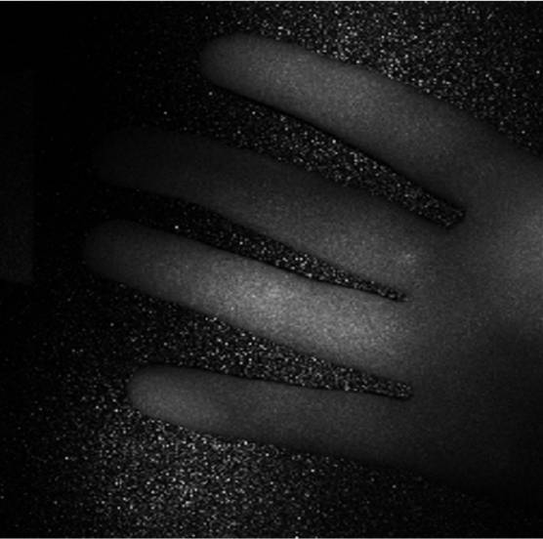
Perfusion Extraction
G-D
Direct Reflectance
LSCI
Slow Fast

Slide 18
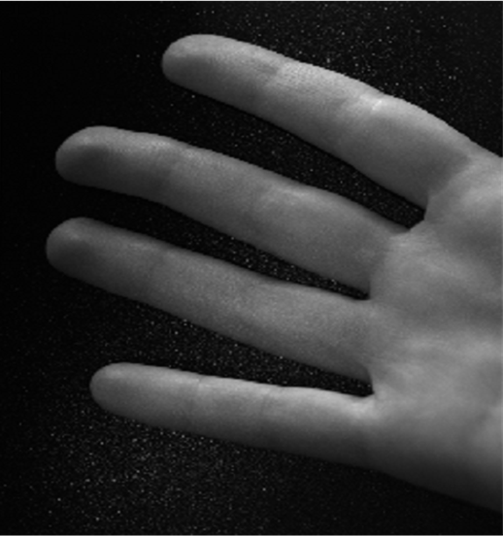
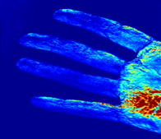
Comparison to Baseline
Baseline
Direct Component
Direct shows significant speckle
Perfusion should be uniform
Slow Fast

Slide 19
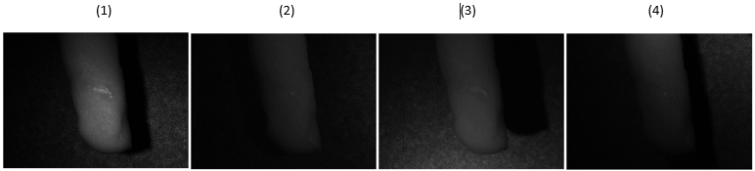
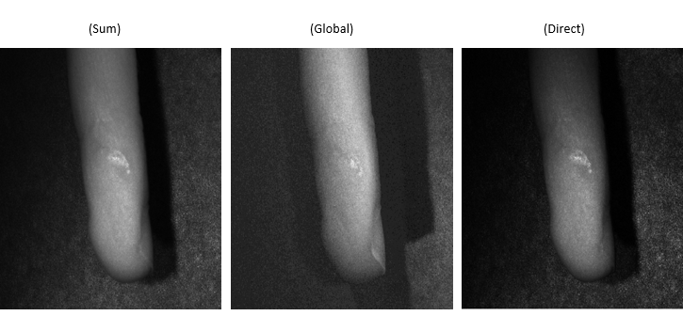
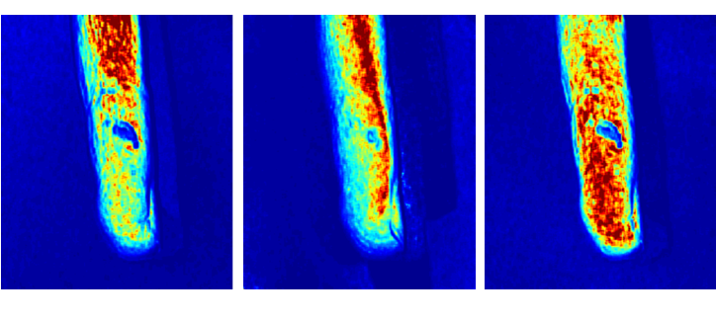
The Burn
Baseline
Direct Component
No perfusion on dead skin
Slow Fast

Slide 20
Information in the Global and Direct
Baseline
Global
Direct
Global has no speckle
Blood speed in veins is ~0
Global is almost identical to baseline
Direct doesn’t contain veins
Slow Fast

Slide 21
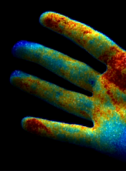
Synthesized Blood Flow Visualization

Slide 22
Contributions and Future Work
Global-direct for skin perfusion reconstruction
Experiment driving theory:
How to incorporate global-direct with diffraction?
New graphics usage models
Computational photography → Medical imaging

